Slide 1
Advanced Front-End Programming (CPAN 144)
Week 9
Lecturer: Harshdeep Singh
Summer 2024

Slide 2
Agenda
React Routing
How Route works in React?
react-router package
BrowserRouter
Linking to a Route
Adding A “Not Found” Route
Adding URL Parameters to Routes

Slide 3
What is Routing?
React Router is a collection of navigational components that compose declaratively with your application.
With ROUTING, we can browse different URLs within our app without reloading the page
In this case, the components of one URL are swapped out for the components of another, giving the illusion that we’re navigating through multiple pages

Slide 4
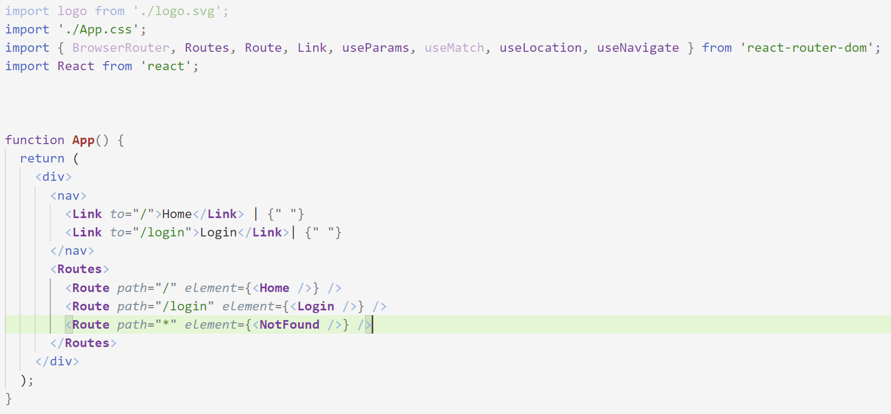
Example

Slide 5
How Route works in React?
The routes are simply added using the following template, between <Routes> tags:
The element (componentName) will be rendered when the "/specifiedPath" is visited on the web app.
<Routes>
<Route path="/specifiedPath" element={componentName} />
</Routes>

Slide 6
Getting Started using React Router
react-router package provides the core routing functionality for React Router
However, if you are writing an application that will run in the browser, you should instead install react-router-dom
Upon installing react-router-dom, it will install react-router as a dependency.
React Router can be installed using the npm cli utility:
npm install react-router-dom --save

Slide 7
Getting Started using React Router
import {
BrowserRouter as Router,
Link,
Route,
Routes,
} from 'react-router-dom';
BrowserRouter
is the router implementation for HTML5 browsers (vs Native).
Link
is your replacement for anchor tags.
Route
is the conditionally shown component based on matching a path to a URL.
Routes
returns only the first matching route rather than all matching routes.

Slide 8
Activity 1
Step 1: add a new component to the /src, name it Routing
Step 2: import the route package: import { Route, Routes } from 'react-router-dom';
Step 3: declare the followings:
const Home = () => <h1>Home</h1>
const Projects = () => <h1>Projects</h1>

Slide 9
Activity 1 – Continued
Add the following to the render() function
<Routes>
<Route path="/" element={<Home />}/>
<Route path="/Projects" element={<Projects/>}/>
</Routes>

Slide 10
Activity 1 – Continued
Call the Routing component from App.js
Run the application. What does happen?

Slide 11
Linking to a Route
To use the react router effectively, we cannot simply use normal links ( <a href=“”… > ) to route to our pages from within the application.
Instead, what we need to do is use the <Link> component (from “react-router-dom”)
<Link to='/myRoute'>My Route</Link>

Slide 12
Activity 1 – Continued
Replace the render() method’s content with the following:
<BrowserRouter>
<div>
<Link to='/'>Home</Link>
<br />
<Link to='/Projects'>Projects</Link>
</div>
<Routes>
<Route path="/" element={Home}/>
<Route path="/Projects" element ={Projects}/>
</ Routes>
</BrowserRouter>
Run the application. What happen?

Slide 13
Adding A “Not Found” Route
To add a “Not Found” route, we simply need to add another route as a child to our <Routes> component defined in App.js:
<Route path="*" element={<NotFound />}/>
And you also need a “Not found” component that informs the user that the path does not exist:
function NotFound()
{
return <p>404</p>
}

Slide 14
useParams Hook

Slide 15
Adding URL Parameters to our Routes
If we wish to pass a specific parameter to a given route the URL pattern would look like:
“/routeName/:id” (for one parameters)
“/routeName/:id/:price” (for two parameters)
… And so on. You can separate each parameter by “/” and each parameter name starts with “:”.
And your route will look like the following:
<Route path=“/Project/:id” element={<Sample/>}>

Slide 16
Importing useParams() Hook
In React Router v6, You Need to use the useParams() hook in your functional components. This is not available in class components since they do not support hooks.
How to import useParams() hook:
import {
BrowserRouter,
Routes,
Route,
Link,
useParams}
from 'react-router-dom';

Slide 17
Using useParams() hook:
Now, if you need to extract a route parameter named “id”, you simply import and access it like:
For one parameter:
function Orders()
{
let { id } = useParams();
return <h1> Order ID : {id}</h1>;
}
Or for multiple parameters:
function Orders()
{
let { id, price } = useParams();
return <h1> Order: {id} , Costs {price} </h1>;
}

Slide 18
Route and Navigate

Slide 19
Route and Navigate
useNavigate is one of the major dependencies of React Router.
Navigate function is returned from the useNavigate hook and allows you to change the URL.
Navigate is mutable.
You can import the navigate hook (useNavigate) like the following:
import {
BrowserRouter,
Routes,
Route,
Link,
useNavigate} from ‘react-router-dom’
And You can use the navigate hook like:
let navigate = useNavigate();
navigate(“/home”)
Read More: https://reactrouter.com/docs/en/v6/getting-started/concepts#navigate-function

Slide 20
Submit your class Activities
Navigate to Course Content -> Assessments -> Labs -> Lab 8 and download the instruction for lab 8.
Once you fulfill all the requirements of the lab, ZIP all your source files and submit them into Course Content -> Assessments -> Labs -> Lab 8
Pay attention to the due date defined on the blackboard submission box for this activity.

